Slide 1
Group behaviour simulation results
Second order Runge Kutta numerical solver
Simulation result of the scenario which illustrates pedestrians moving to group members( by using repulsive and attractive forces)
Simulation result of the scenario which illustrates group of pedestrians escaping together and maintaining group behaviour (by adding desired moving direction)
Simulation result of the scenario which illustrates different groups
Notes:
An equation that consists of derivatives is called a differential equation
http://people.du.ac.in/~pmehta/FinalSem/Renukafinal.pdf

Slide 2

1.Runge–Kutta method
Initial value problem [1] $\dot{y}=f(t,y)$ , $y(t_{0})=y_{0}$
Given a step-size h>0, RK-4 approximates $y_{t+1}$by the present value $y_{n}$ plus the weighted average of four increments, where each increment is the product of the size of the interval, h, and slopes k estimated by the function f of the differential equation
$$y_{n+1}=y_{n}+ \frac{1}{6}(k_{1}+ 2k_{2}+ {2k}_{3}+ k_{4})$$
$$t_{n+1}=t_{n}+h$$
where
$$k_{1}=hf\left(t_{n}, y_{n}\right)$$
$$k_{2}=hf\left(t_{n}+\frac{h}{2}, y_{n}+ \frac{1}{2}k_{1}\right)$$
$$k_{3}=hf\left(t_{n} +\frac{h}{2}, y_{n}+ \frac{1}{2}k_{2}\right)$$
$$k_{4}=hf\left(t_{n}+h, y_{n}+k_{3}\right)$$
.
Notes:
Aim to approximate a y is an unknown function (vector) of time t which we would like to approximate; $\dot{y}$ is a function of time t and of y itself.

Slide 3
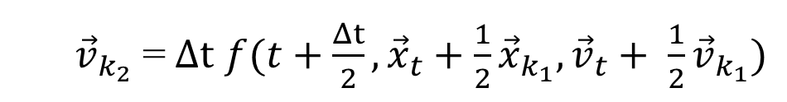
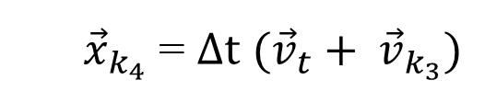
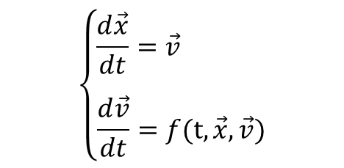
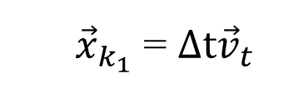
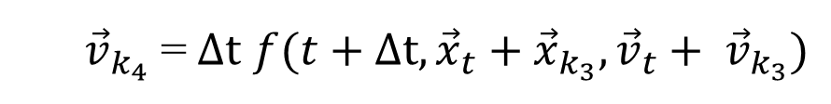
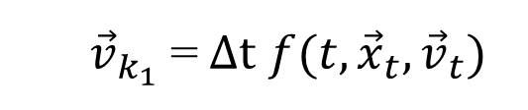
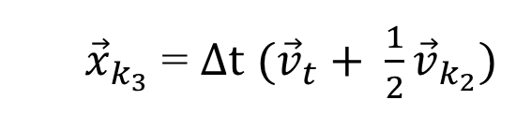
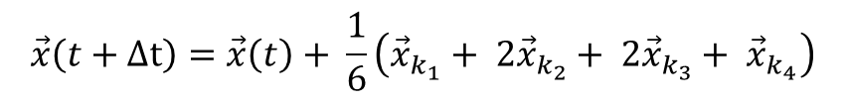
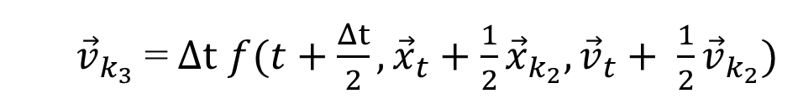
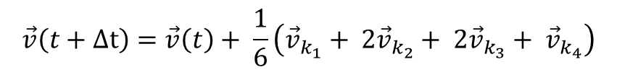
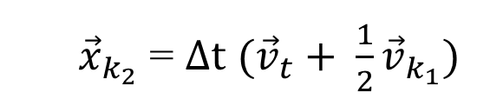
1. Runge–Kutta method to update velocity and position
Given the below system simulating the position and velocity of a group member p based on the force-based model:
$$\left\{\begin{aligned}&\frac{d\vec{x}}{dt}=\vec{v} \\ & \\ \frac{d\vec{v}}{dt}=f(t,\vec{x},\vec{v})\end{aligned}\right.$$
$$\vec{v}\left(t+Δt\right)=\vec{v}\left(t\right)+ \frac{1}{6}\left({\vec{v}}_{k_{1}}+ 2{\vec{v}}_{k_{2}}+ 2{\vec{v}}_{k_{3}}+ {\vec{v}}_{k_{4}}\right)$$
$$\vec{x}\left(t+Δt\right)=\vec{x}\left(t\right)+ \frac{1}{6}\left({\vec{x}}_{k_{1}}+ 2{\vec{x}}_{k_{2}}+ 2{\vec{x}}_{k_{3}}+ {\vec{x}}_{k_{4}}\right)$$
where
${\vec{v}}_{k_{1}}$ =$Δt$ $f(t,{\vec{x}}_{t},{\vec{v}}_{t})$
${\vec{x}}_{k_{1}}$ = $Δt{\vec{v}}_{t}$
${\vec{v}}_{k_{2}}$ =$Δt$ $f(t+\frac{Δt}{2}, {\vec{x}}_{t}+\frac{1}{2}{\vec{x}}_{k_{1}},{\vec{v}}_{t}+ \frac{1}{2}{\vec{v}}_{k_{1}})$
${\vec{x}}_{k_{2}}$ = $Δt$ $({\vec{v}}_{t}+ \frac{1}{2}{\vec{v}}_{k_{1}})$
${\vec{v}}_{k_{3}}$ =$Δt$ $f(t+\frac{Δt}{2}, {\vec{x}}_{t}+\frac{1}{2}{\vec{x}}_{k_{2}},{\vec{v}}_{t}+ \frac{1}{2}{\vec{v}}_{k_{2}})$
${\vec{x}}_{k_{3}}$ = $Δt$ $({\vec{v}}_{t}+ \frac{1}{2}{\vec{v}}_{k_{2}})$
${\vec{v}}_{k_{4}}$ =$Δt$ $f(t+Δt, {\vec{x}}_{t}+{\vec{x}}_{k_{3}},{\vec{v}}_{t}+ {\vec{v}}_{k_{3}})$
${\vec{x}}_{k_{4}}$ = $Δt$ $({\vec{v}}_{t}+ {\vec{v}}_{k_{3}})$
Each above increment is calculated simultaneously for all group members to make sure that members are calculated at proper positions and velocities at times t, and $t+\frac{Δt}{2}$, and $t+Δt$.
Notes:
And other reference,
http://rosettacode.org/wiki/Runge-Kutta_method#C
https://people.sc.fsu.edu/~jburkardt/cpp_src/rk4/rk4.cpp
http://deepanshubhatti.blogspot.com.au/2013/10/to-solve-differential-equation-by_6120.html
http://www.maths.tcd.ie/~ryan/TeachingArchive/161/teaching/harm_osc_rk.c.html

Slide 4
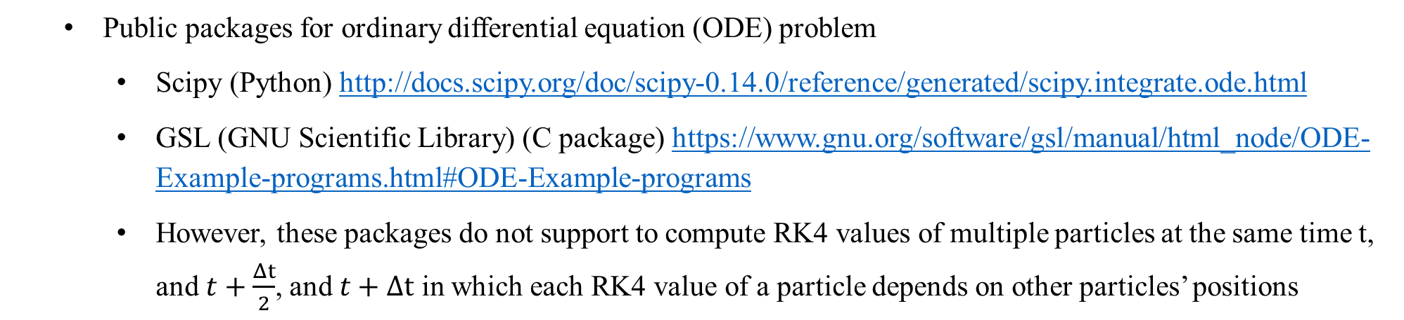
1. RK Reference
Reference for RK4 solver for two simultaneous equations of N-body Mass Gravitational Problem
http://web.mit.edu/pkrein/Public/Final%20Paper%20UW324.pdf
http://www.engr.colostate.edu/~thompson/hPage/CourseMat/Tutorials/CompMethods/Rungekutta.pdf
http://physics.bu.edu/~py502/slides/l07.pdf
Public packages for ordinary differential equation (ODE) problem
Scipy (Python) http://docs.scipy.org/doc/scipy-0.14.0/reference/generated/scipy.integrate.ode.html
GSL (GNU Scientific Library) (C package) https://www.gnu.org/software/gsl/manual/html_node/ODE-Example-programs.html#ODE-Example-programs
However, these packages do not support to compute RK4 values of multiple particles at the same time t, and $t+\frac{Δt}{2}$, and $t+Δt$ in which each RK4 value of a particle depends on other particles’ positions
RK4 method and force model are computed at C level to boost performance. Python is used to initialize parameter and visualize simulation
Notes:
Only allow to compute information of one particle. We also need to compute RK4 for other particles at the same time.

Slide 5
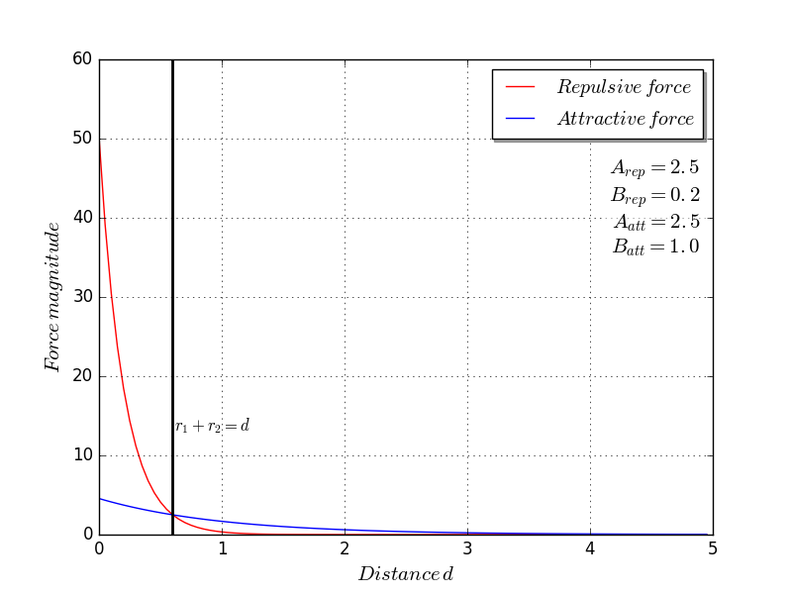


2. Simulation result of the model using repulsive and attractive forces
$\vec{f_{p}}\left(t\right)$ = $\sum_{q(≠p)}{{\vec{f}}_{pq}^{rep}\left(t\right)+ \sum_{q(≠p)}{{\vec{f}}_{pq}^{att}\left(t\right)}}$
$${\vec{f}}_{pq}^{rep}\left(t\right)=A_{rep}e^{\left(\frac{(R_{p}+R_{q})−d_{pq}}{B_{rep}}\right)}\vec{u_{qp}}$$
Repulsive force created by pedestrian q on pedestrian p
$${\vec{f}}_{pq}^{att}\left(t\right)=A_{att}e^{\left(\frac{(R_{p}+R_{q})−d_{pq}}{B_{att}}\right)}\vec{u_{pq}}$$
Attractive force represents that p moves close to pedestrian q
$B_{rep}<B_{att}$ to make group members come close to each other
Notes:
As mentioned by Helbing, Vicsek []

Slide 6
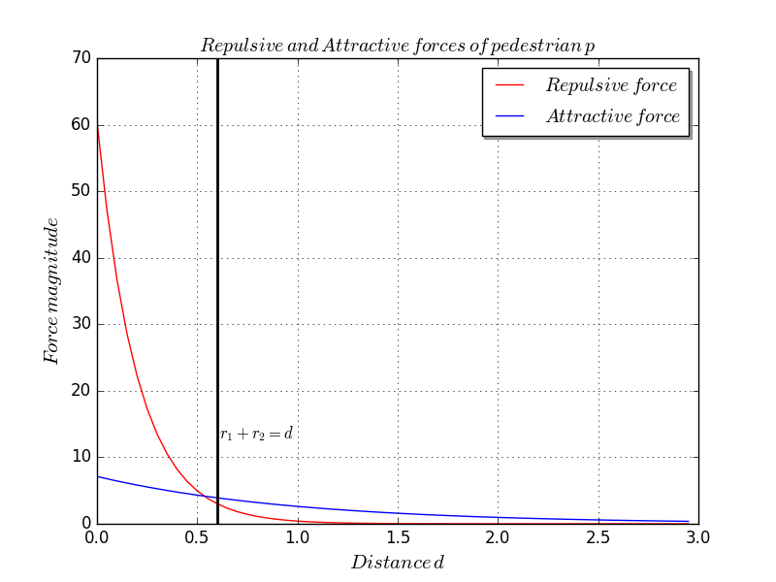
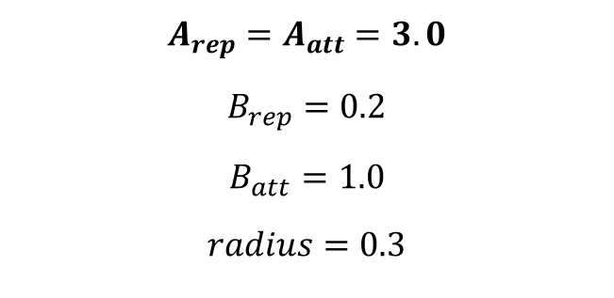
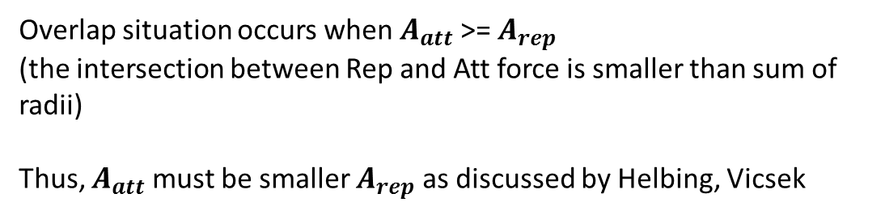
2. Simulation result of the model using repulsive and attractive forces
p
q
k
Overlap situation
Given a simulation of three pedestrians on 1-D at time t where
pedestrians q and k are collide
pedestrians p, q, k share the same parameter values:
d
$$A_{rep}=A_{att}=3.0$$
$$B_{rep}=0.2$$
$$B_{att}=1.0$$
$$radius=0.3$$
Overlap situation occurs when $A_{att}$ >= $A_{rep}$
(the intersection between Rep and Att force is smaller than sum of radii)
Thus, $A_{att}$ must be smaller $A_{rep}$ as discussed by Helbing, Vicsek
Notes:
As mentioned by Helbing, Vicsek []
Step 1. As Helbing, Molnar, .. We should set A_att smaller than in setting distribution parameter to simulate realistic.

Slide 7
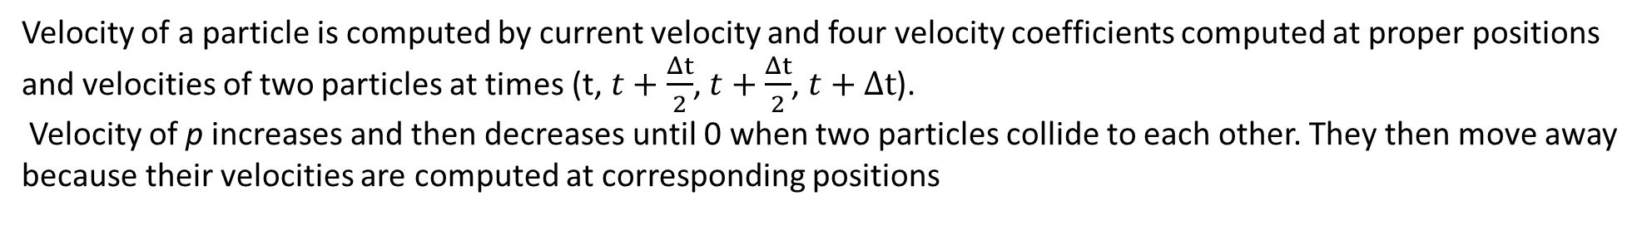


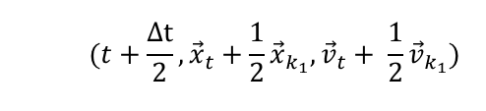

2. Simulation result of two group members
Why do two pedestrians move away when they are close to each other?
Velocity of a particle is computed by current velocity and four velocity coefficients computed at proper positions and velocities of two particles at times (t, $t+\frac{Δt}{2}$, $t+\frac{Δt}{2}$, $t+Δt$).
Velocity of p increases and then decreases until 0 when two particles collide to each other. They then move away because their velocities are computed at corresponding positions
p
q
p
q
$(t,{\vec{x}}_{t},{\vec{v}}_{t})$
$$(t+\frac{Δt}{2}, {\vec{x}}_{t}+\frac{1}{2}{\vec{x}}_{k_{1}},{\vec{v}}_{t}+ \frac{1}{2}{\vec{v}}_{k_{1}})$$
p
q
p
q
$$(t+\frac{Δt}{2}, {\vec{x}}_{t}+\frac{1}{2}{\vec{x}}_{k_{2}},{\vec{v}}_{t}+ \frac{1}{2}{\vec{v}}_{k_{2}})$$
p
q
p
q
p
q
q
$$(t+Δt, {\vec{x}}_{t}+{\vec{x}}_{k_{3}},{\vec{v}}_{t}+ {\vec{v}}_{k_{3}})$$
p
Two particles stop when they collide
Two pedestrians move away after collided
Notes:
1- Write t + deltaT = t + deltat/2, t +
2- run with simulation, plot v-distance by t-
Could not find a point to make v = 6 (2l1)
Preserve their original velocity- inertia to move away
3- plot when running with one object public package

Slide 8
2. Simulation result of two group members
Why do two particles move away when they are close to each other?
Velocity of a particle over the time
Distance between two particles over the time
Notes:
1- Write t + deltaT = t + deltat/2, t +
2- run with simulation, plot v-distance by t-
Could not find a point to make v = 6 (2l1)
Preserve their original velocity- inertia to move away
3- plot when running with one object public package

Slide 9
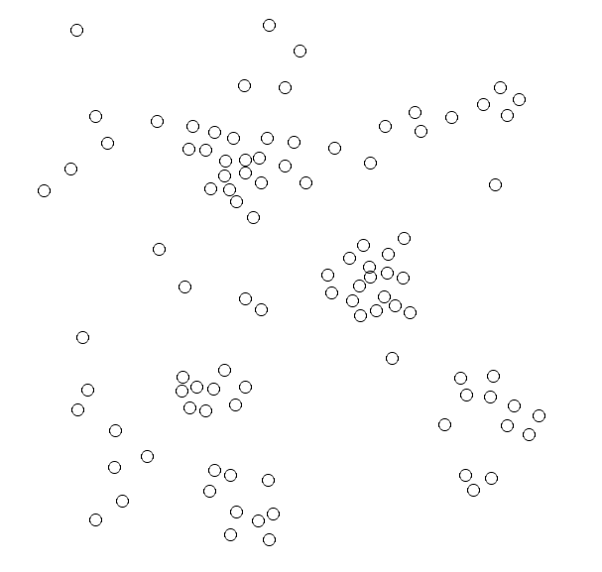
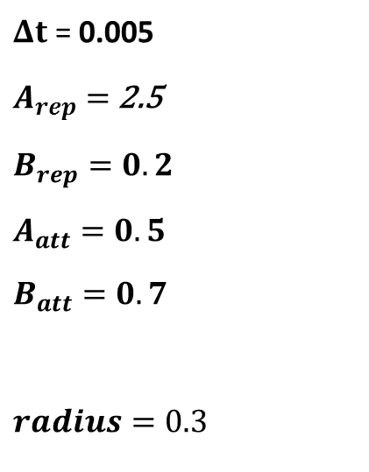
2. Simulation result of the model using repulsive and attractive forces
N = 100, group is automatically split into smaller groups as the group theorem from previous paper
$Δt$ = 0.005
$A_{rep}=$ 2.5
$$B_{rep}=0.2$$
$$A_{att}=0.5$$
$$B_{att}=0.7$$
$$radius=0.3$$

Slide 10
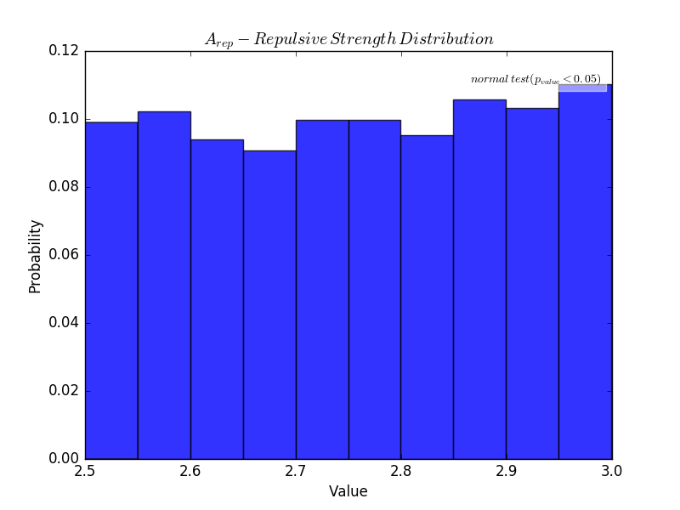
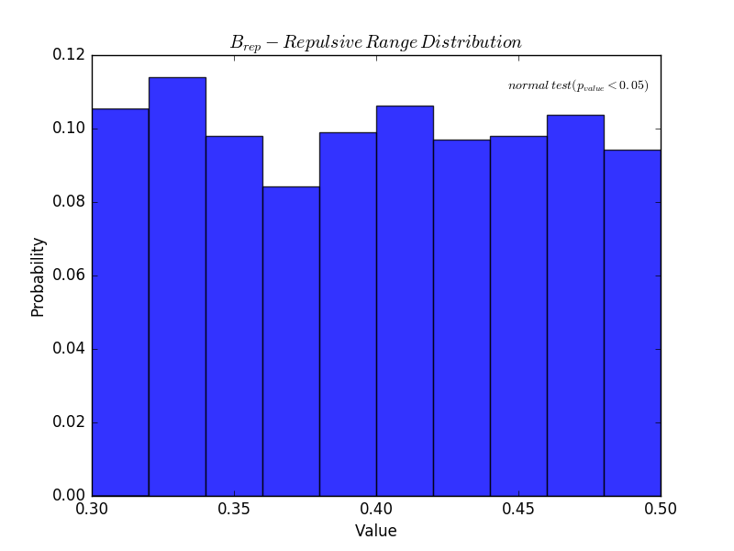
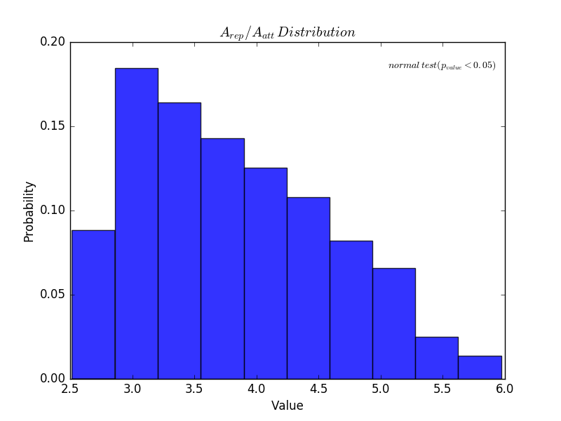
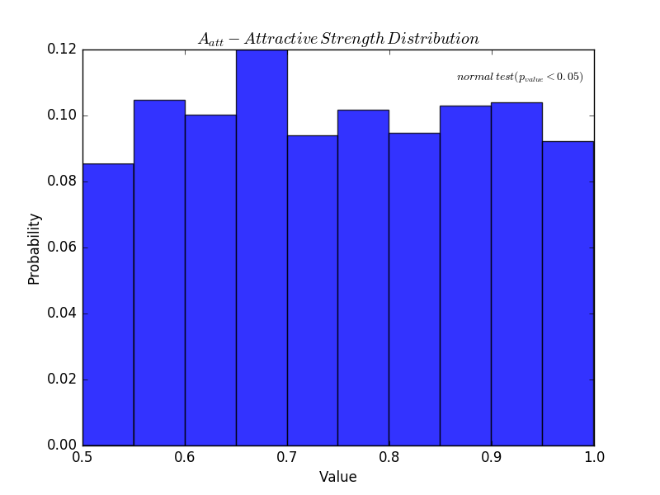
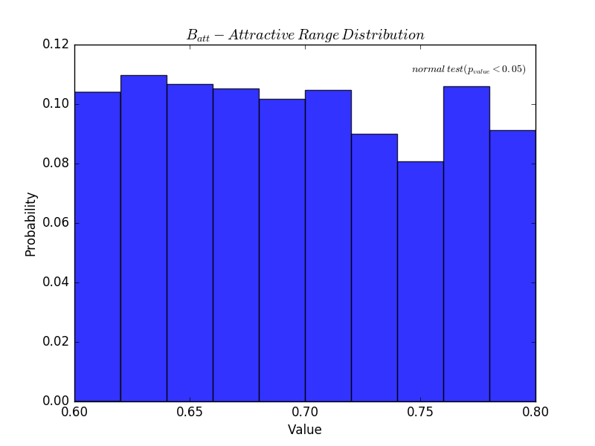
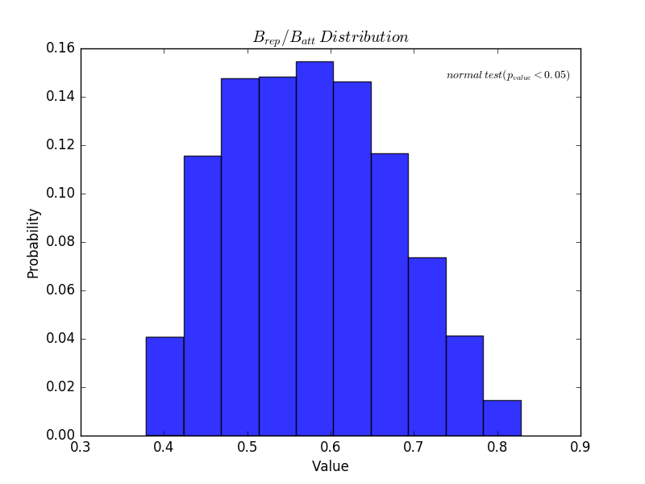
2. Simulation result of the model using repulsive and attractive forces
Notes:
1000 samples for each parameter
Given commonly and calibrated A_rep, B_rep of previous Helbing’s study, A_att, B_att is selected so that thay are not overlap.
, N= 10, N = 20, N = 40 will be simulated later
Adaptive, change values over the time, depend on leader, or group population size

Slide 11
2. Simulation result of the model using repulsive and attractive forces
Group of N= 5 members
Notes:
Groups of N= 5 pedestrians are simulated on Monash Campus Cluster to obtain $A_{rep}$/$A_{att}$, $B_{rep}$/$B_{att}$ and Sobol contribution indices of parameters
Sobol by R
Which parameter control group is the crucial information to help us simulate the interrelation between different groups

Slide 12
3. Simulation result of the model using both desired, repulsive, and attractive forces
Group of N= 10 members
Notes:
Groups of N= 10 pedestrians are simulated on Monash Campus Cluster to obtain $A_{rep}$/$A_{att}$, $B_{rep}$/$B_{att}$ and Sobol contribution indices of parameters
Tartpoint is far, could not reach, 40 second monitoring period, randomly, each combination is simulated 10 times., share same placement between different parameter combinations

Slide 13
4. Simulation result of the scenario which illustrates different groups
Groups with different sizes, check group cohesion degree of each group and flow rate of each group?
Is the flow rate of groups different from the flow rate of the scenario without group behaviour?

